Slide 1
Black Carbon

Slide 2
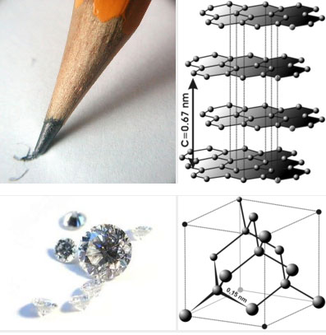
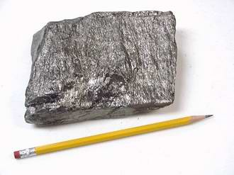
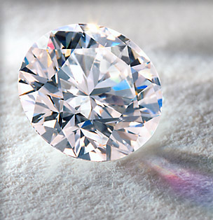
Different Forms of Elements
Elements are always pure, but do not always look the same
Example: carbon
diamond
graphite

Slide 3
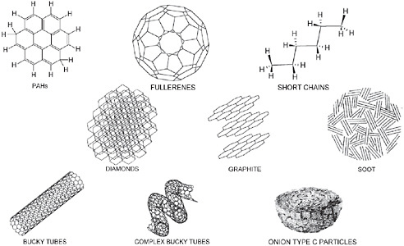
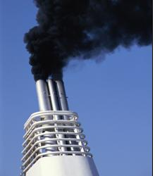
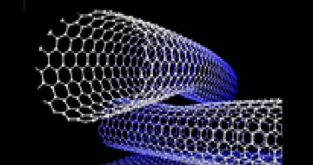
Forms of carbon, cont.
BLACK CARBON
carbon nanotubes

Slide 4
What is carbon?
An element (number 6)
6 protons
Sixth-most abundant element in the universe
Typical forms
Soot
Graphite
Diamond
Fullerenes
Essential for life
Has 15 isotopes (varieties)
Approximately ten million compounds contain carbon
Common compounds
Carbon dioxide - CO₂
Methane - CH₄
Vinegar - CH₃COOH

Slide 5
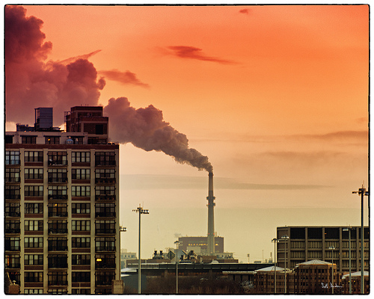
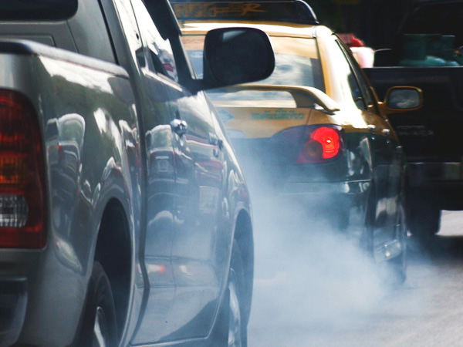
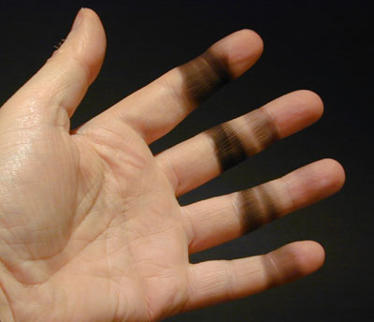
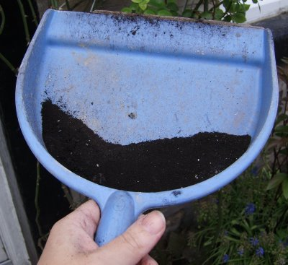
What is black carbon?
A product from incomplete combustion (burning)
Soot
Particles thousands of times smaller than the width of a human hair
Can travel long distances on air currents
Falls out of the air in 7-10 days due to rain, etc
“Short-lived climate forcing”
Causes warming

Slide 6
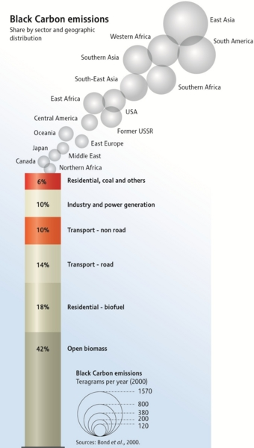
Where does black carbon come from?
Top producers
East Asia
South America
Western Africa
Top sector (area/branch)
Biomass burning
Residential – biofuel
Transport - road

Slide 7
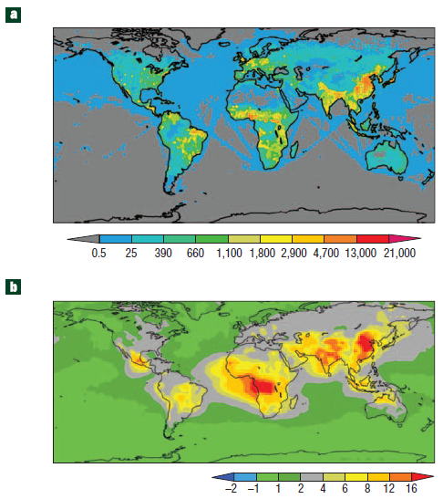
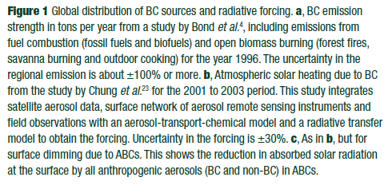
Where is black carbon?
A) Global distribution of black carbon emissions (tons/year)
B) Estimated global radiative forcing due to black carbon (W/m²)

Slide 8
Why should we care about black carbon?
Contributes to climate change (warming) in two ways
Absorbing sunlight and heating air around it
Falling on snow or ice, decreasing reflectivity, and increasing melting
BC absorbs heat a million times more than CO₂
Contributes to regional heating
Disrupts rainfall patterns
Reducing black carbon output could slow warming by 0.1 – 0.2 ºC
ENVIRONMENT

Slide 9
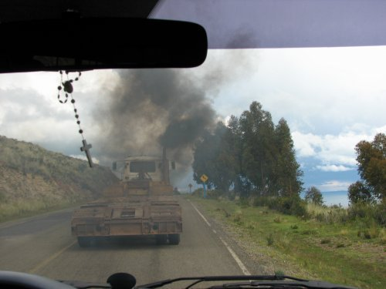
Why should we care about black carbon?
Reductions would prevent 2.4 million premature deaths worldwide
Particulate emissions from diesel exhaust (major source of BC) are linked to lung and heart disease, as well as cancer
HEALTH

Slide 10
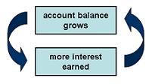
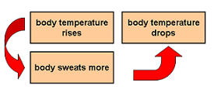
Feedback Loops
Positive Feedback
Reaction enhances original stimulus
“Runaway effect”
Promotes instability and change
Negative Feedback
Reaction negates original stimulus
Whether too high, or too low, negative feedback brings it back to a set point
Promotes stability and constancy

Slide 11
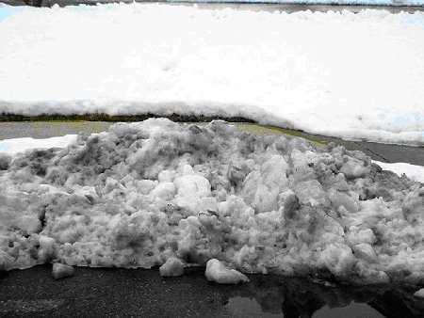
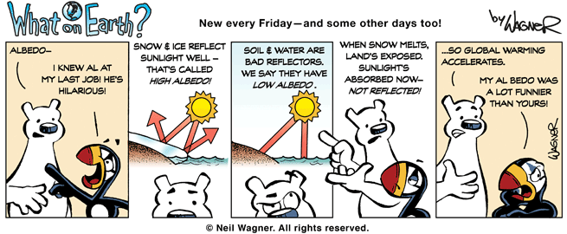
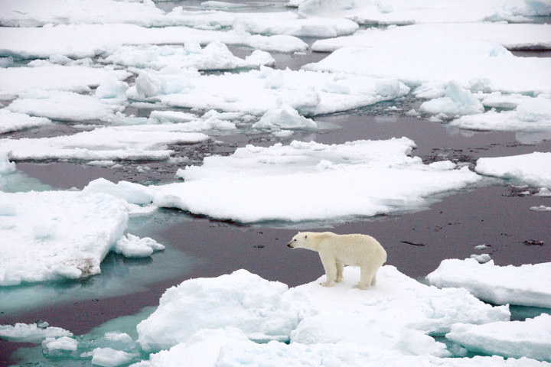
Albedo and Arctic Climate
← Which snow will melt faster? Why?
→
What is going to happen in this situation?

Slide 12
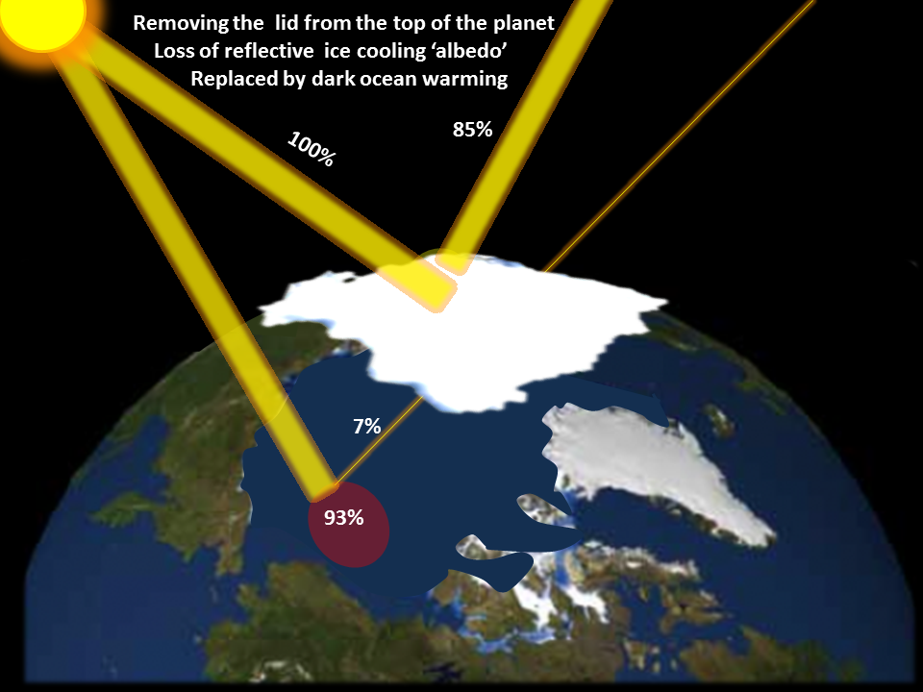
Albedo

Slide 13
Albedo
Albedo: the fraction of incoming radiation (light) that is reflected by a surface
Scale from 0 – 1 (0% - 100%)
Low albedo
Reflects sunlight well
Ice
Snow
Sand
High albedo
Absorbs sunlight well
Forests
Oceans
Soil

Slide 14
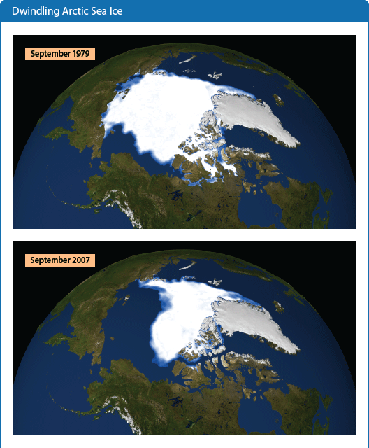
Arctic Sea Ice
What happens to incoming sunlight in each case?
What does this mean in terms of the snow-albedo feedback loop?

Slide 15
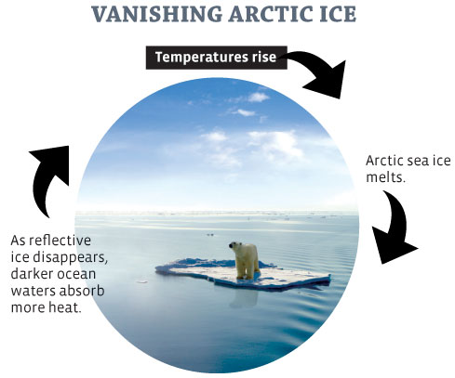
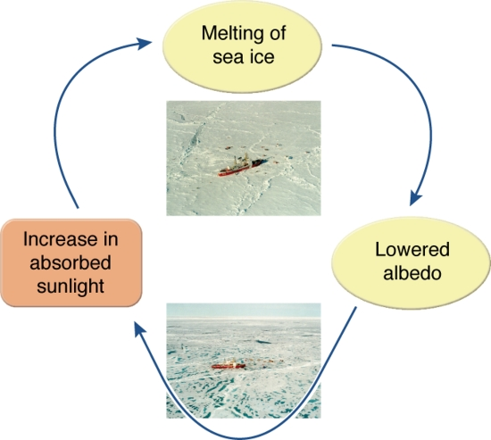
Snow-Albedo Feedback Loop
these loops show the same type of change (positive feedback) in two different ways

Slide 16
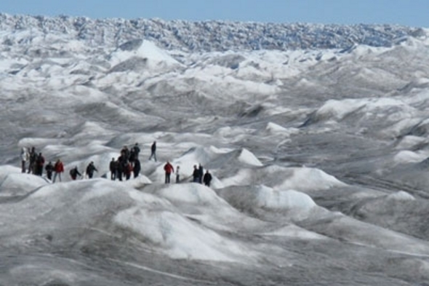
Black Carbon in the Arctic
Black carbon falls on snow and ice
↓
Albedo decreases
↓
More sunlight is absorbed
↓
Melting increases
Is this a positive or negative feedback loop?

Slide 17
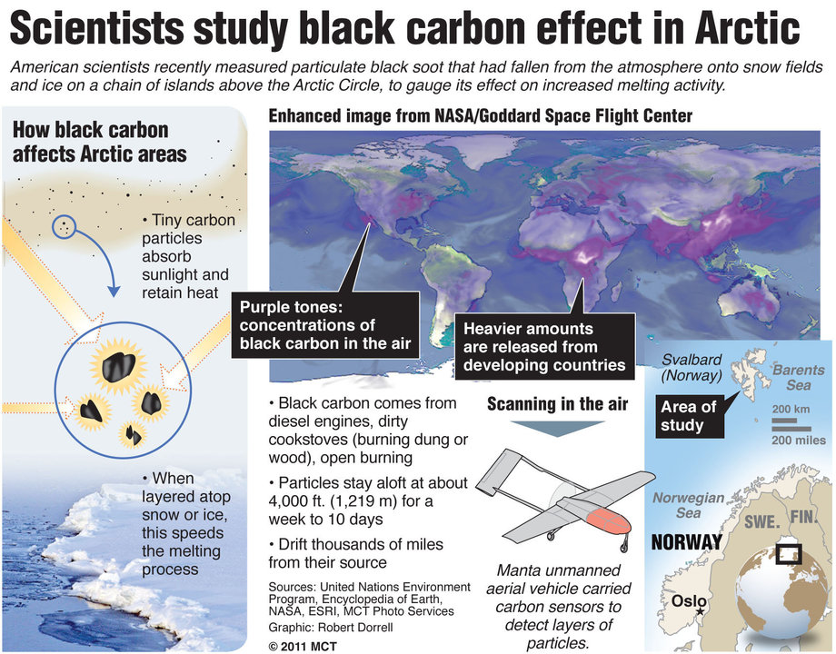
Summary

Slide 18
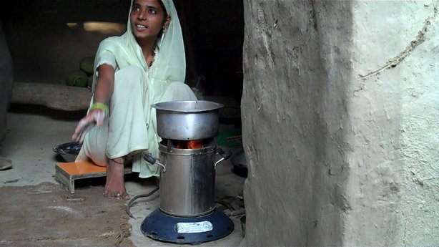
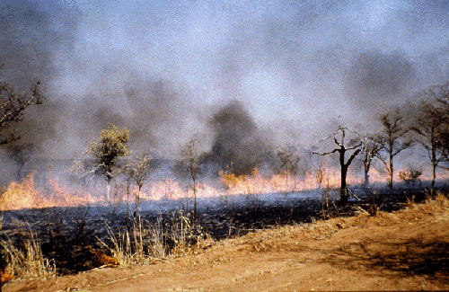
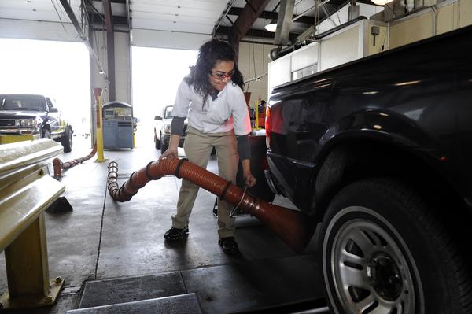
What can be done?
Replace traditional cook and heat stoves in developing countries with clean-burning biomass stoves or alternate energy sources
Install filters on diesel vehicles
Create tighter restrictions on diesel vehicles
Eliminate open field burning of agricultural waste

Slide 19
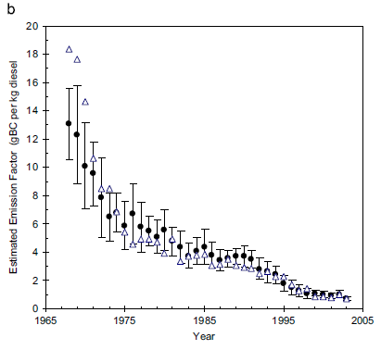
How well do changes work?
Rate of decline = 1 – 13 = .33 g BC/kg diesel
2003 – 1967 per year
Regulations were implemented in California to reduce emissions
The black dots are the average black carbon emission over time

Slide 20
Sources
http://education.jlab.org/itselemental/ele006.html
http://education.jlab.org/itselemental/iso006.html
http://www.nature.com/ngeo/journal/v1/n4/pdf/ngeo156.pdf
http://online.santarosa.edu/homepage/cgalt/BIO10-Stuff/Ch21-Animal_Structure_Function/Feedback-Loops-Summary.jpg
http://www.mcclatchydc.com/2011/05/05/113755/scientists-measure-arctic-soot.html
http://www.eoearth.org/article/Black_Carbon_and_Climate_Change?topic=49491
http://www.skepticalscience.com/soot-and-global-warming.html
http://ac.els-cdn.com/S1352231007008631/1-s2.0-S1352231007008631-main.pdf?_tid=ad6773f6b4dda3b1ca25ed539b4c9465&acdnat=1342547970_8c20062180cef755b59ded99f8e8a1ab

Slide 21
Image Sources
http://blog.iqsdirectory.com/wp-content/uploads/files/graphite%204.jpg
https://www.e-education.psu.edu/earth520/files/earth520/pencils_diamonds.jpg
http://www.a1-diamond.com/
http://www.nap.edu/books/12951/xhtml/images/p2001c7c7g77001.jpg
http://www.grc.nasa.gov/WWW/RT/RT2001/images/5410hepp1-f1.jpg
http://www.climate.org/programs/images/smokestack.JPG
http://www.dnr.state.md.us/education/envirothon/2004art/snow.jpg
http://earthobservatory.nasa.gov/Features/SeaIce/images/sea_ice_polar_bear.jpg
http://epa.gov/climatechange/images/indicator_figures/sea-ice-figure2.gif
http://www.climate-emergency-institute.org/uploads/Arctic_albedo_1.png
http://foreignpolicyblogs.com/wp-content/uploads/ice-albedo-feedback-process.jpg
http://www.yesmagazine.org/images/issues/88/45Pandora_LoopIceTEXT.jpg
http://www.talkingscience.org/wp-content/uploads/2010/09/WOE_150Albedo.gif
http://www.nature.com/ngeo/journal/v1/n4/pdf/ngeo156.pdf
http://politicalclimate.files.wordpress.com/2010/07/feedbacks-schematic.png?w=460
http://ipy.no/imagearchive/stort_hovedtekstbilde_greenland_402_None_full.jpg
http://media.mcclatchydc.com/smedia/2011/05/06/22/20110506_ARCTICSOOT.large.prod_affiliate.91.jpg
http://www.neptuneproducts.co.nz/site/rosmac/files/images/Environment/TruckSmoke109_1_1.jpg
http://kpbs.media.clients.ellingtoncms.com/img/photos/2012/01/17/wood_stove_t614.jpeg?a3ca5463f16dc11451266bb717d38a6025dcea0e
http://www.nasa.gov/images/content/159505main_biomass_burn_lg.jpg
http://extras.mnginteractive.com/live/media/site36/2011/0415/20110415__EMISSIONS~p1.jpg
http://2.bp.blogspot.com/-uJ_RbBOYMdE/T5XITZy_zAI/AAAAAAAAAdA/RQoCNc4e3To/s1600/Fire_-_Soot_on_a_Hand%5B1%5D.jpg
http://3.bp.blogspot.com/_C5cFhlHoXiU/SgmoroodRmI/AAAAAAAAAVI/wdmfrqCbm3A/s400/soot.JPG
http://news.stanford.edu/news/2010/july/images/soot_news.jpg
http://c1ecolocalizercom.wpengine.netdna-cdn.com/files/2012/06/chicago-soot-swanksalot.jpg
http://ac.els-cdn.com/S1352231007008631/1-s2.0-S1352231007008631-main.pdf?_tid=ad6773f6b4dda3b1ca25ed539b4c9465&acdnat=1342547970_8c20062180cef755b59ded99f8e8a1ab

